Slide 1

Student Name : Rutuja Saharkar
AICTE Internship ID
APPLY_175602876668aadf5ea2d8b

Slide 2

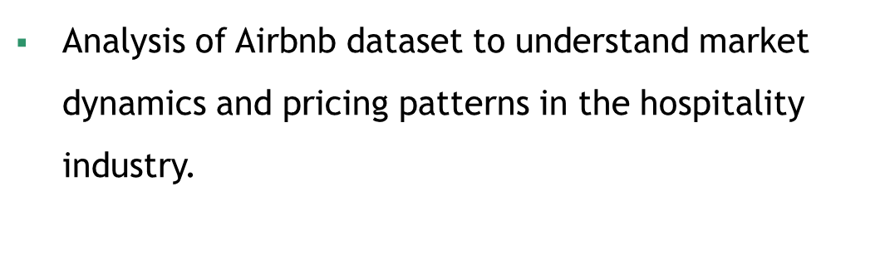


Slide 3

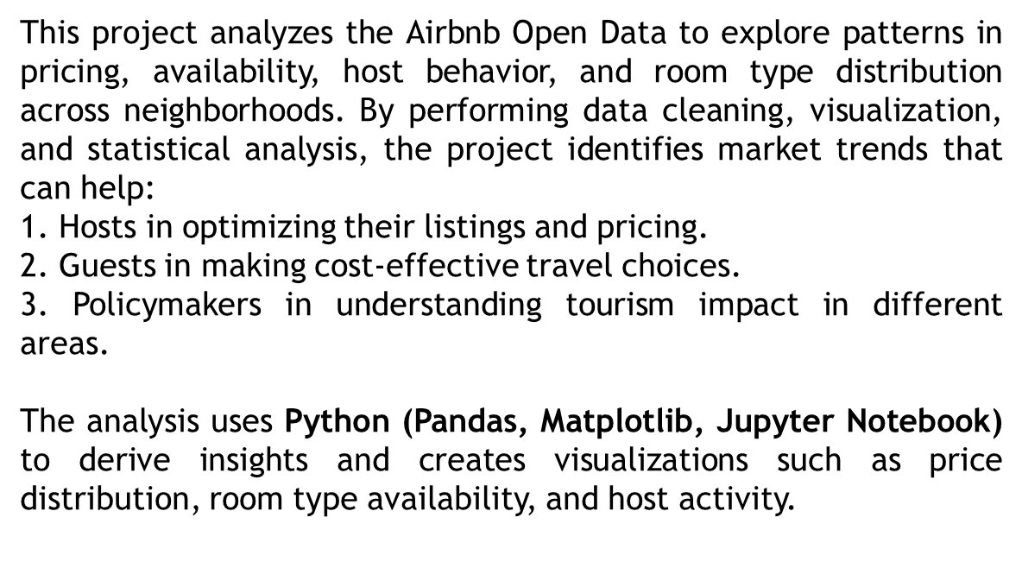


Slide 4




Slide 5
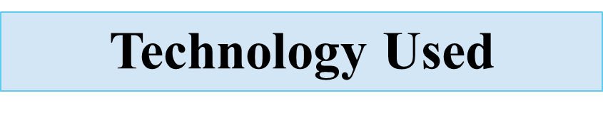



Slide 6
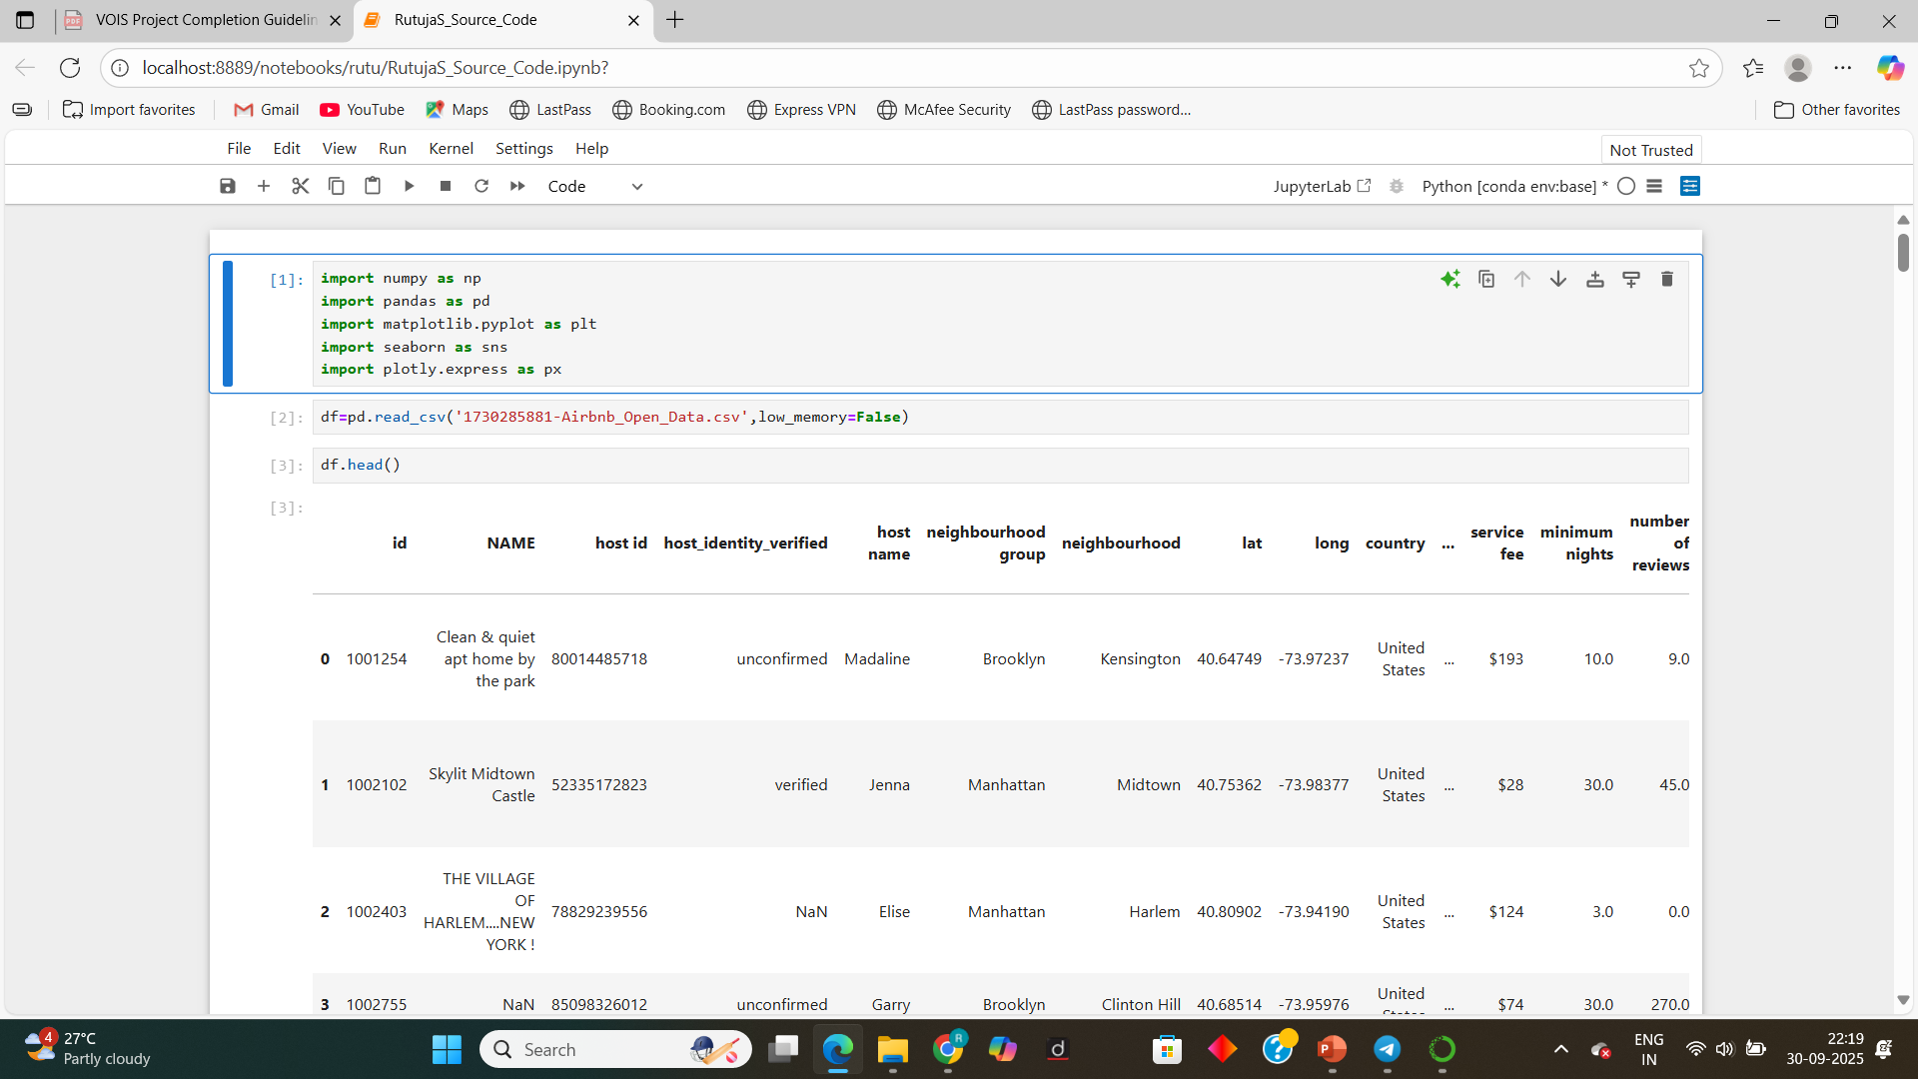
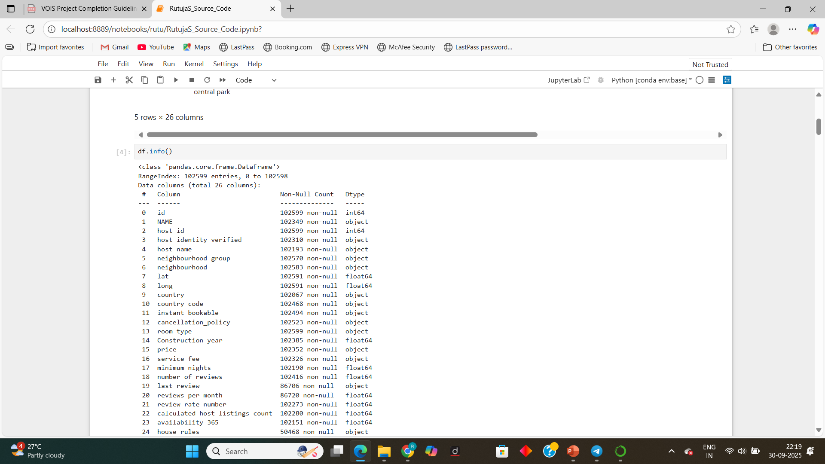
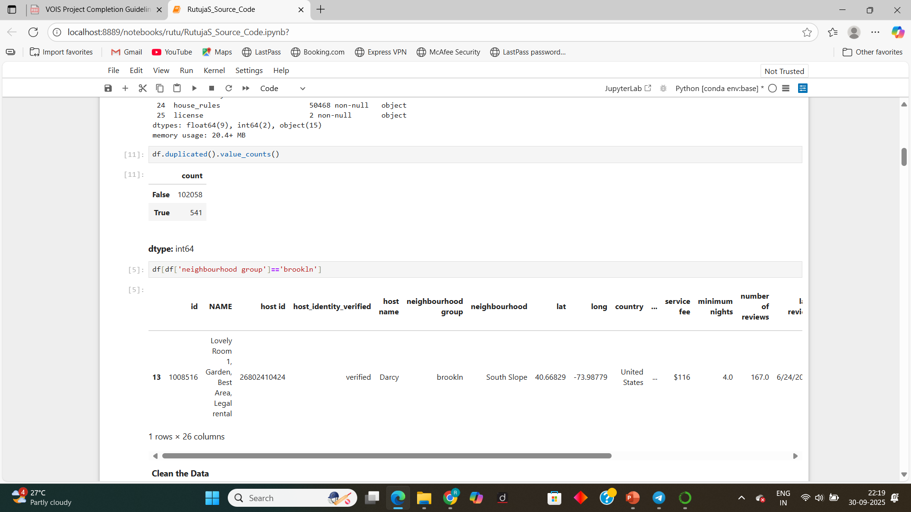
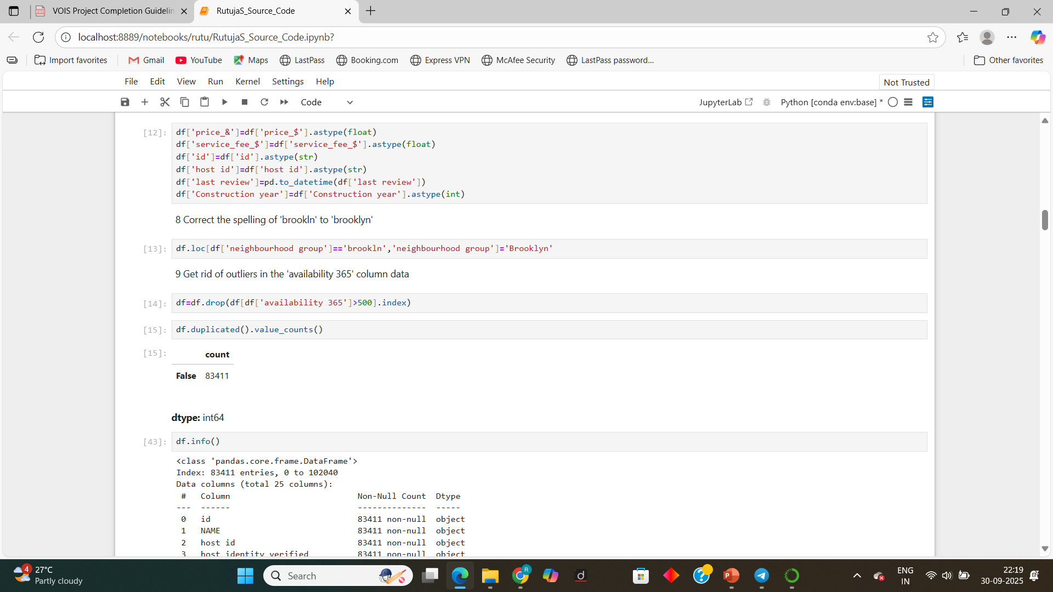
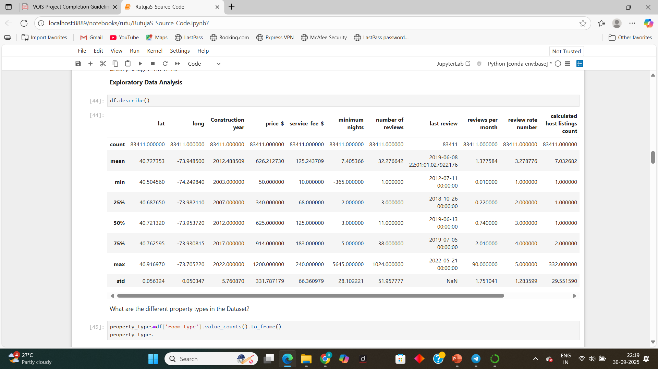
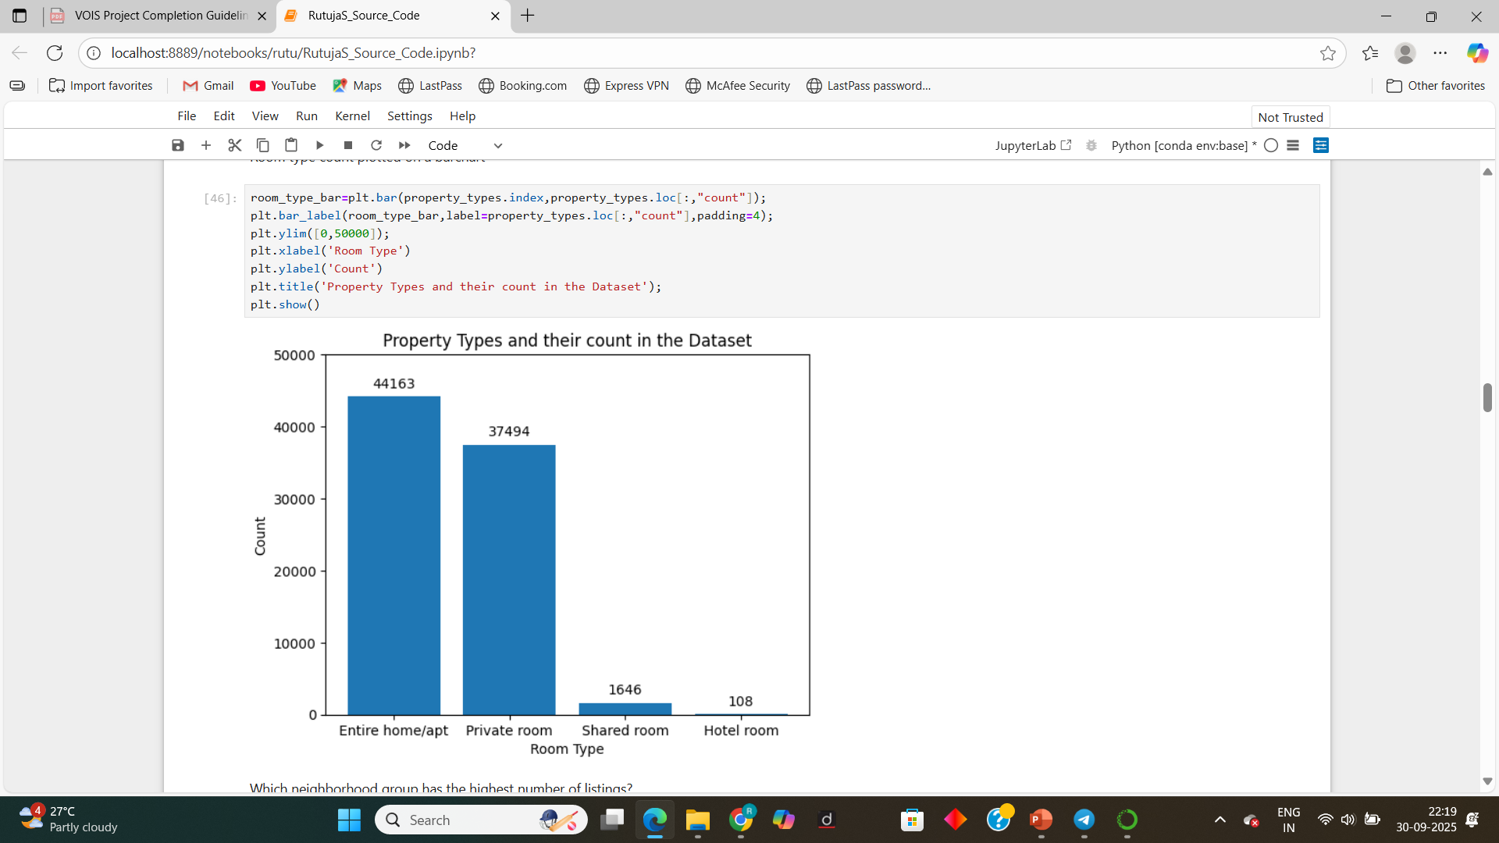
RESULTS-1
Demo Link

Slide 7
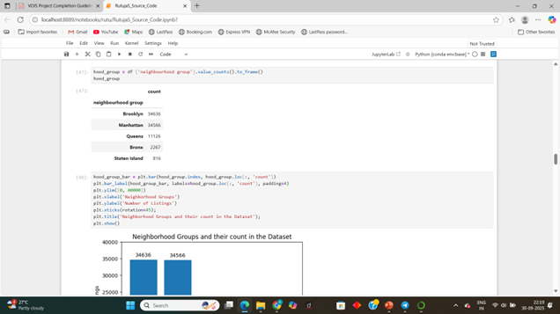
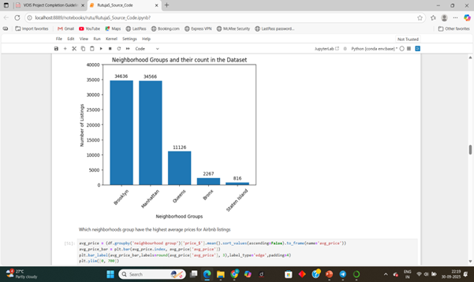
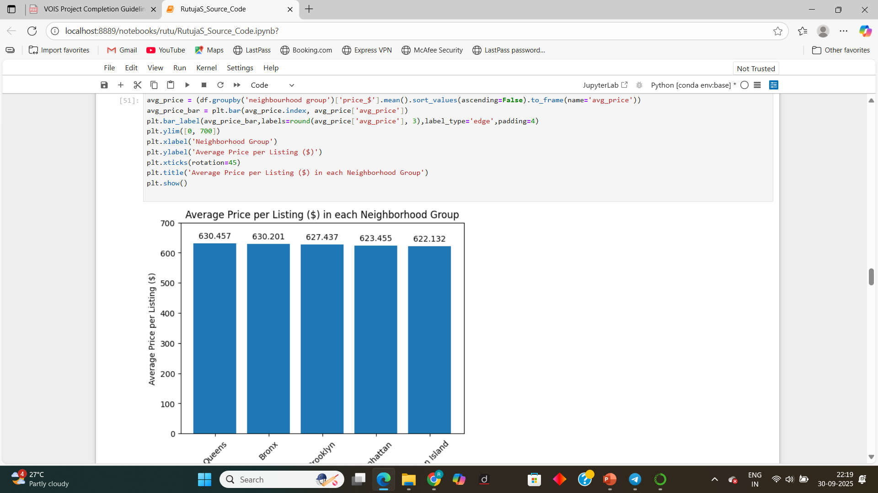
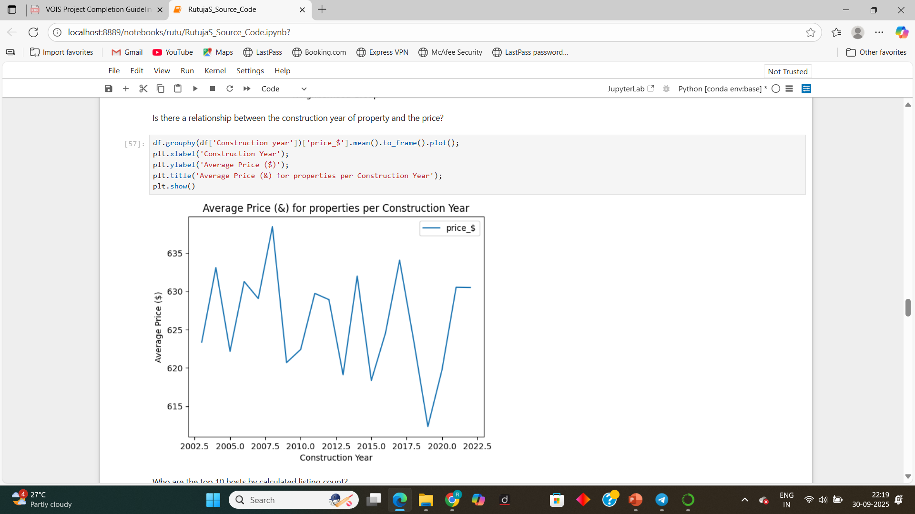
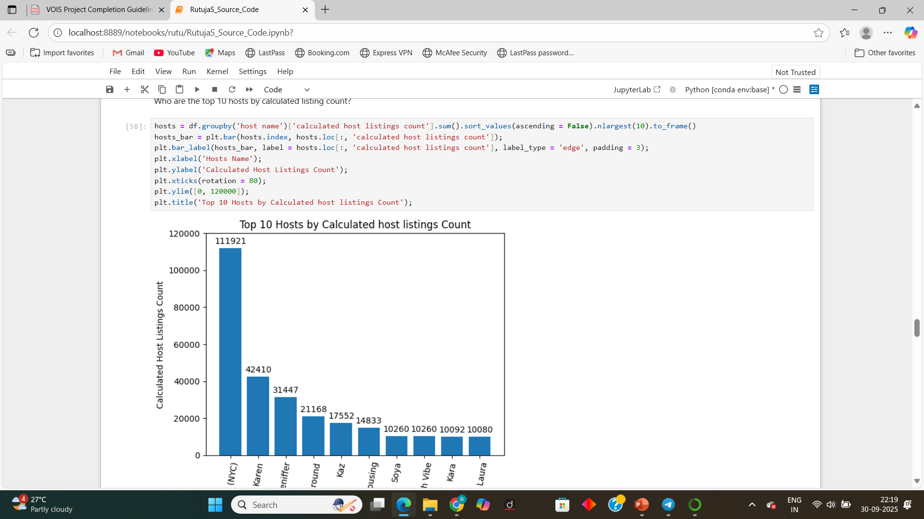
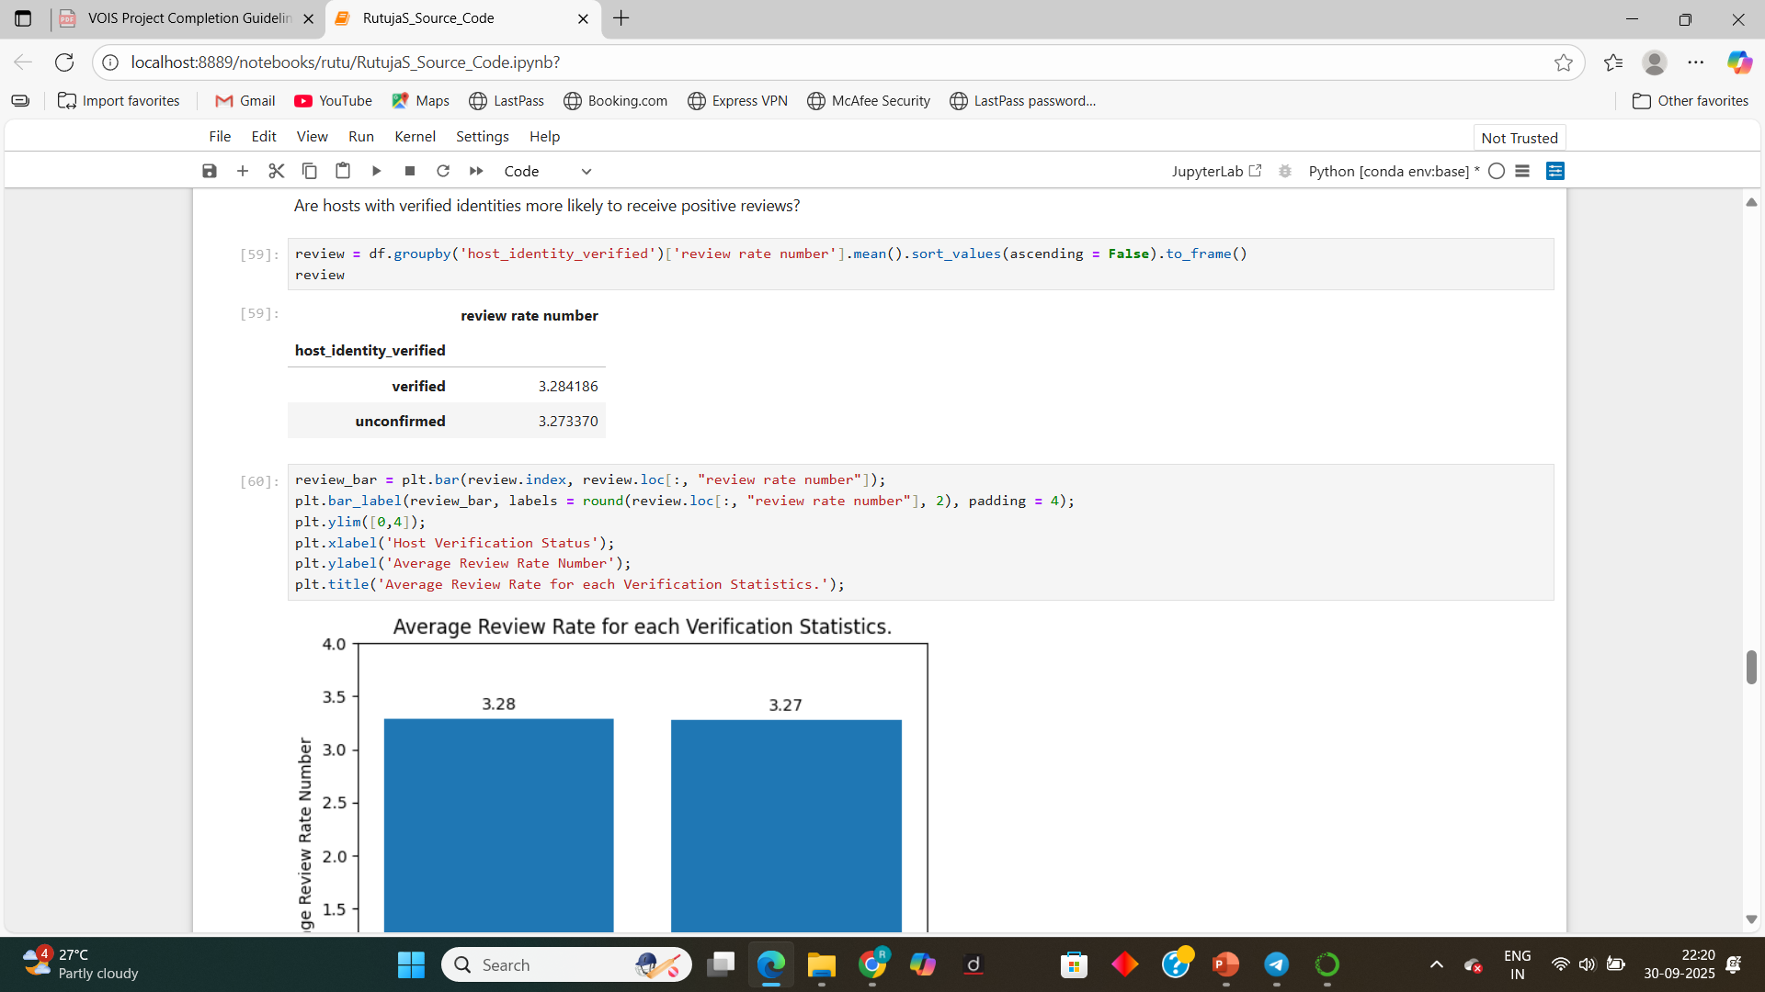
RESULTS-2
Demo Link

Slide 8
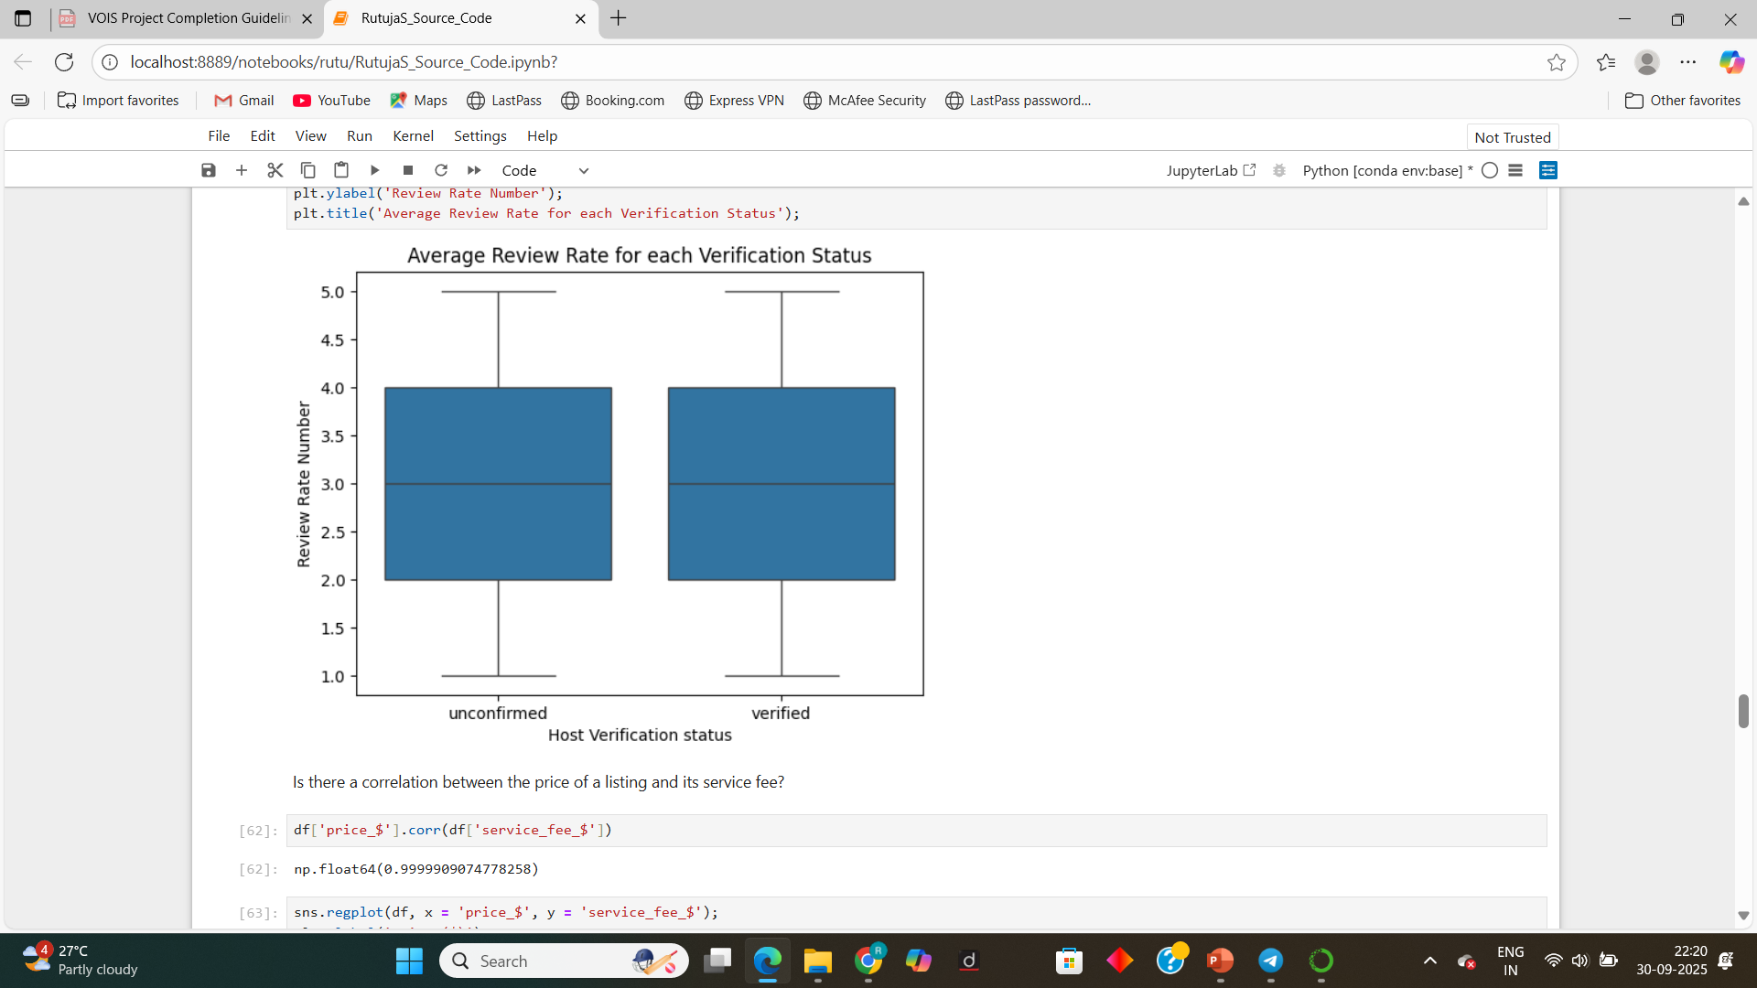
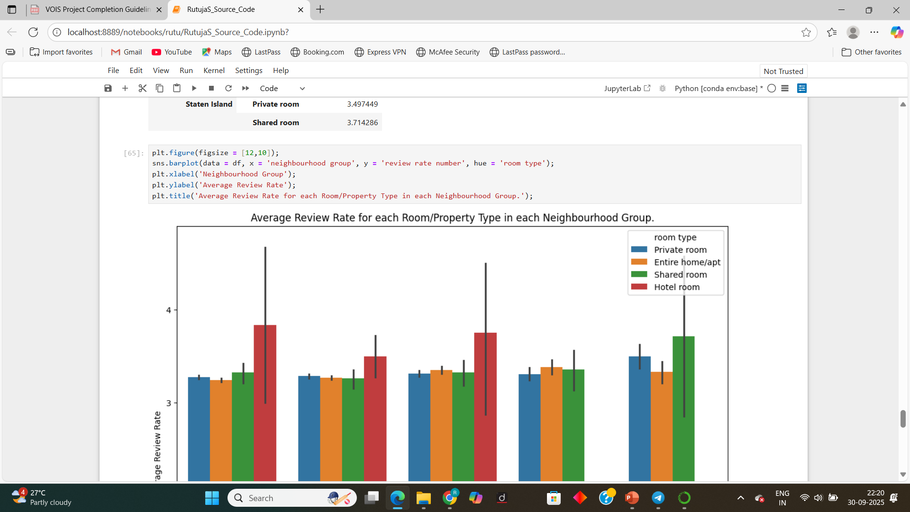
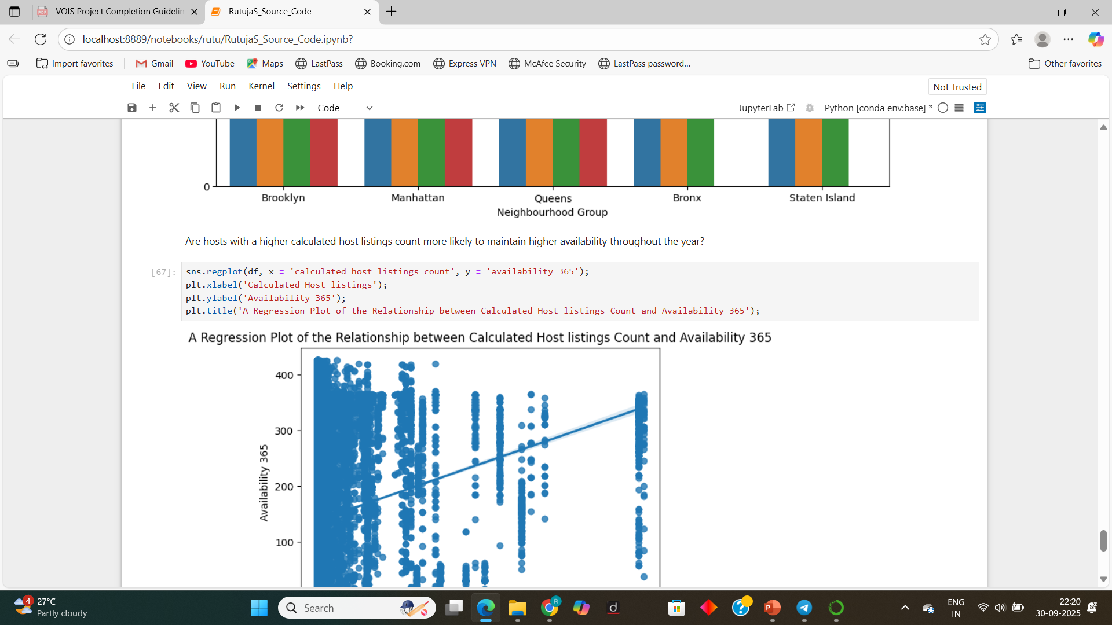
RESULTS-3
Demo Link

Slide 9
GitHub Repository
GitHub Project Link:
https://github.com/RutujaS-2110/VOIS_AICTE_Oct2025_RutujaSaharkar
VOIS_AICTE_Oct2025_RutujaSaharkar
Demo Link

Slide 10
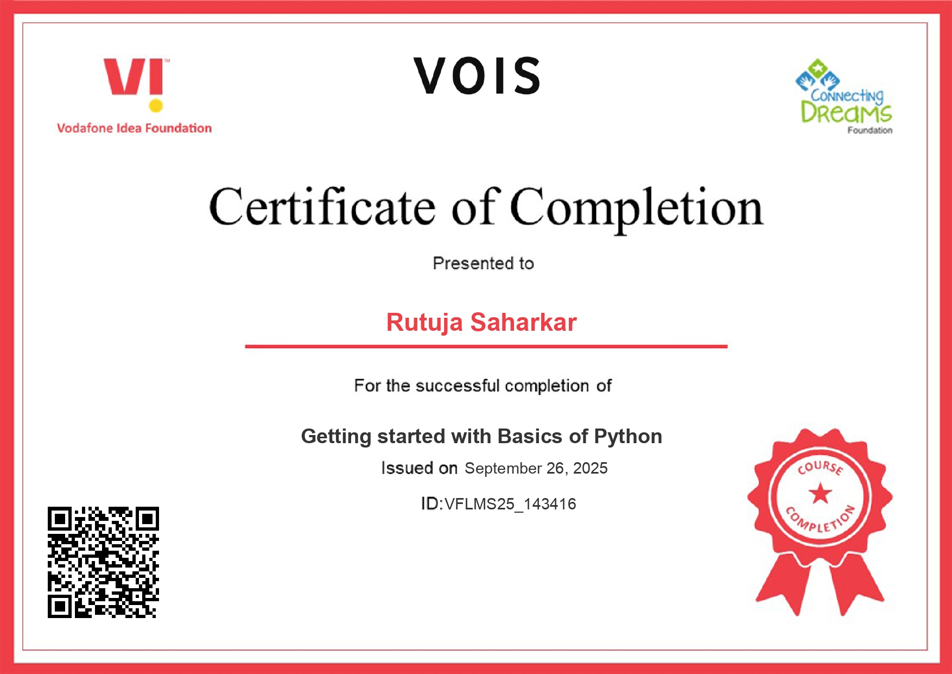
Getting started with Basics of Python Certificate

Slide 11

Data Visualization Certificate

Slide 12
Thank You
.
.

